Slide 1

Slope Intercept form Derivative Introduction
RCET 0264 Introductory Calculus
Tim Leishman

Slide 2
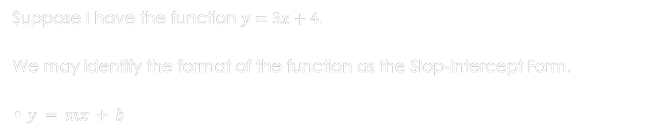
Slope intercept form & Derivative Introduction
Suppose I have the function $y=3x+4$.
We may identify the format of the function as the Slop-Intercept Form.
• $y = mx + b$

Slide 3
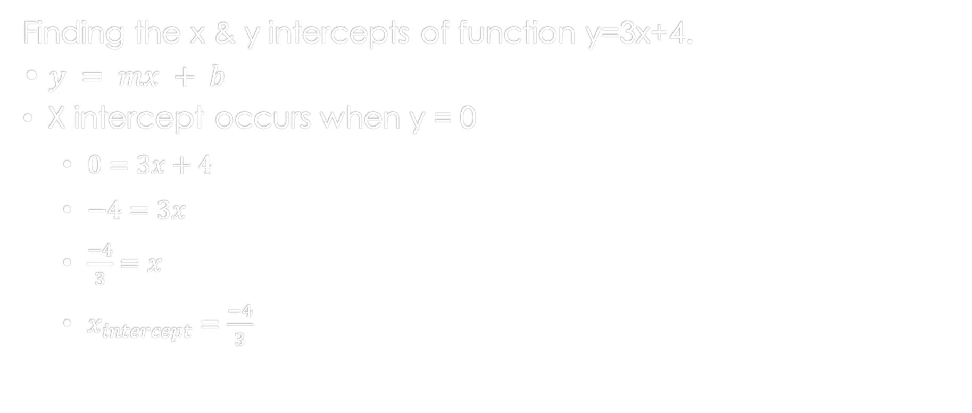
Slope intercept form & Derivative Introduction
Finding the x & y intercepts of function y=3x+4.
• $y = mx + b$
X intercept occurs when y = 0
$0=3x+4$
$−4=3x$
$\frac{−4}{3}=x$
$x_{intercept}=\frac{−4}{3}$

Slide 4
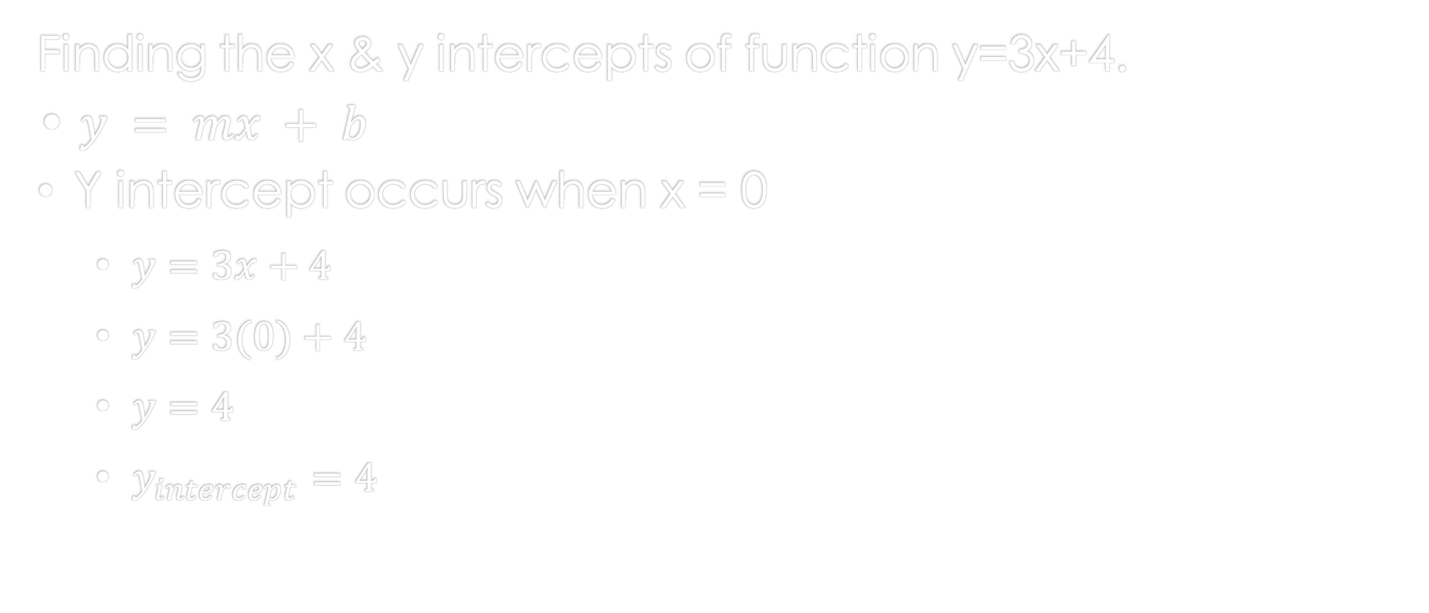
Slope intercept form & Derivative Introduction
Finding the x & y intercepts of function y=3x+4.
• $y = mx + b$
Y intercept occurs when x = 0
$y=3x+4$
$y=3(0)+4$
$y=4$
$y_{intercept}=4$

Slide 5
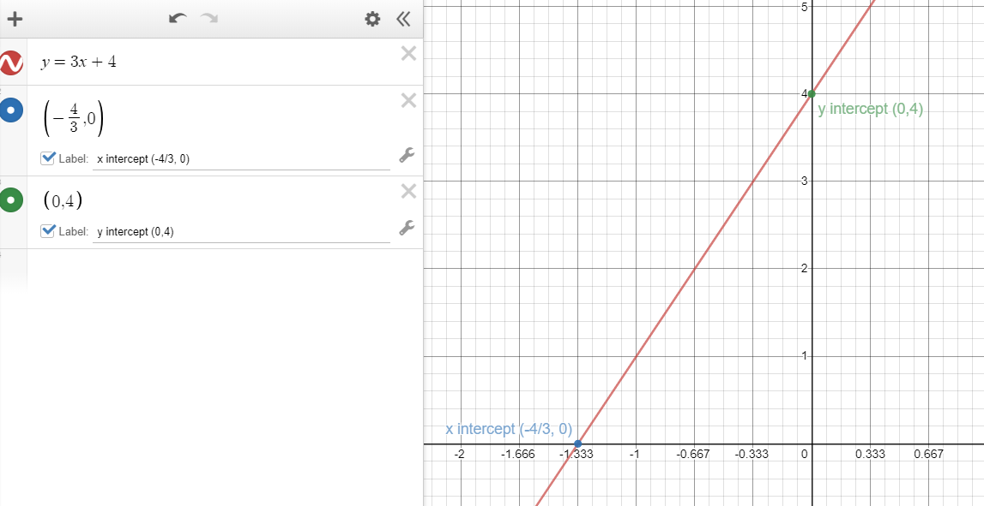
Slope intercept form & Derivative Introduction
Graphical Analysis of the function y=3x+4.
Using Graphical Analysis of the function y=3x+4 will allow us to visually see all x & y values in relation to each other. Including the intercepts.

Slide 6
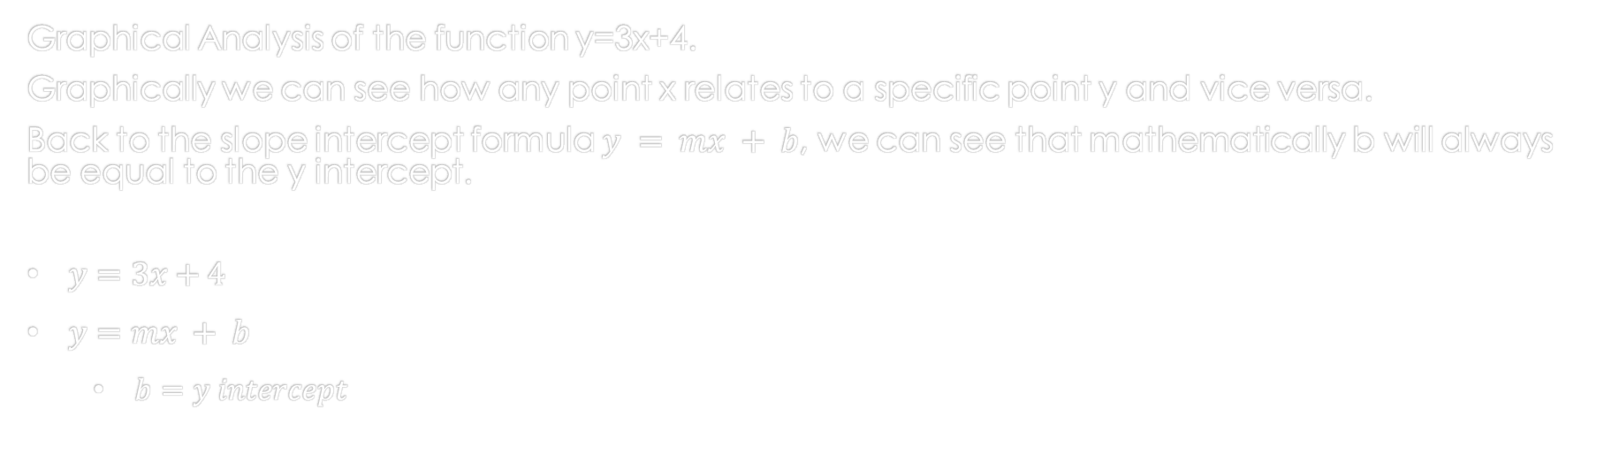
Slope intercept form & Derivative Introduction
Graphical Analysis of the function y=3x+4.
Graphically we can see how any point x relates to a specific point y and vice versa.
Back to the slope intercept formula $y = mx + b$, we can see that mathematically b will always be equal to the y intercept.
$y=3x+4$
$y=mx + b$
$b=y intercept$

Slide 7
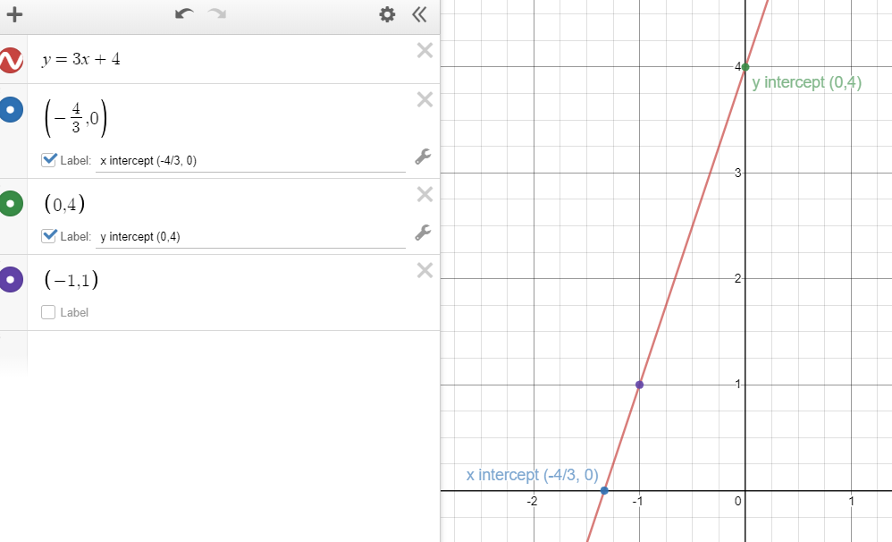


Slope intercept form & Derivative Introduction
Now what does m represent ? $m$ is known as the slope of the line and can be defined as how the line is changing from left to right on the graph y/x.
$m= \frac{The change in y}{The change in x}$ $OR$ $\frac{y1 −y2}{x1−x2}$ $OR$ $\frac{∆y}{∆x}$
$y=mx + b$
$y=3x+4$
we can see that $m=3$in our formula.
Changing the graph to a 1 to 1 ratio x vs. y we can see the nature of the slope.
And from the graph we can measure the slope.

Slide 8

Slope intercept form & Derivative Introduction
Now what does m represent ? $m$ is known as the slope of the line and can be defined as how the line is changing from left to right on the graph y/x.
$y=mx + b$
$y=3x+4$
we can see that $m=3$in our formula.
Picking the points (-1, 1) to (0, 4) we see that x is moving in a positive direction by 4 minor divisions. And from that point to y we have 12 minor divisions in the positive y direction.
$m= \frac{The change in y}{The change in x}=\frac{12}{4}=3$
OR use the intercepts exclusively,
$m= \frac{The change in y}{The change in x}=\frac{4}{(4/3)}=3$
For a straight line the slope will always be the same.

Slide 9
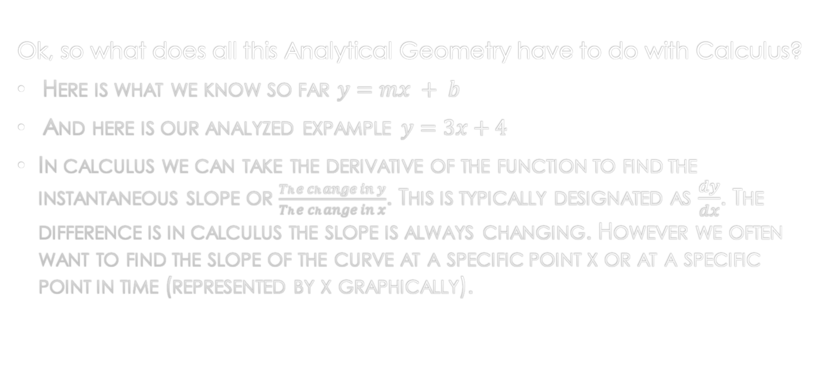
Slope intercept form & Derivative Introduction
Ok, so what does all this Analytical Geometry have to do with Calculus?
Here is what we know so far $y=mx + b$
And here is our analyzed expample$y=3x+4$
In calculus we can take the derivative of the function to find the instantaneous slope or $\frac{The change in y}{The change in x}$. This is typically designated as $\frac{dy}{dx}$. The difference is in calculus the slope is always changing. However we often want to find the slope of the curve at a specific point x or at a specific point in time (represented by x graphically).

Slide 10

Slope intercept form & Derivative Introduction
Ok, so what does all this Analytical Geometry have to do with Calculus?
Here is what we know so far $y=mx + b$
And here is our analyzed expample$y=3x+4$
To take the derivative of any function we can follow the following steps:
If $y=ax^{n}$ ,then $\frac{dy}{dx}=anx^{n−1}$
$y$ is $y$ and $x$ is $x$
$a$ is the number in front of $x$
$n$ is the exponent of $x$

Slide 11

Slope intercept form & Derivative Introduction
Ok, so what does all this Analytical Geometry have to do with Calculus?
Derivative steps applied:
If $y=ax^{n}$ ,then $\frac{dy}{dx}=anx^{n−1}$
Our example:
$y=3x+4$
$y=3x^{1}+4x^{0}$
$\frac{dy}{dx}=3(1)x^{\left(1−1\right)}+4(0)(NA)$
$\frac{dy}{dx}=3(1)x^{0}+0$
$\frac{dy}{dx}=3(1)(1) +0$
$\frac{dy}{dx}=3$
We can now see that the derivative of a function is equal to the slope or instantaneous slope in calculus.
$m= \frac{The change in y}{The change in x} OR \frac{y1 −y2}{x1−x2} OR \frac{∆y}{∆x}$ & $\frac{dy}{dx}$
This relationship is an important concept to understand and will be applied throughout calculus.

Slide 12
Slope intercept form & Derivative Introduction
References:
Ewen, D., Gary, J. S., & Trefzger, J. E. (2005). Technical calculus. Upper Saddle River, NJ: Pearson/Prentice Hall.
Richmond, A. E., & Hecht, G. W. (1995). Calculus for electronics. New York: Glence.
https://www.desmos.com

